Slide 1
Catalyst
On your handout, answer the following questions.
What lesson objective did you elicit observations with?
What task or question did you pose to students for them to make observations on?
What evidence do you have that the task or question made observations accessible to all your students?
What did students say that you did not expect? How did you respond or how would you respond differently next time?

Slide 2
Objective
CMWBAT articulate the need to elicit students’ hypotheses in a science classroom
CMWBAT elicit their students’ hypotheses based on observations to describe natural phenomena and make science relevant
CMWBAT create meaningful and effective group work for their students

Slide 3
Agenda
Catalyst/Objective (10 minutes)
What is Eliciting Hypotheses (20 min)
The Cycle of Intellectual Engagement
What is Eliciting Hypotheses
Classroom Example
Creating Meaningful Group Work (10 min)
Nature of the Tasks Assigned
Assigning students to groups
Fostering Student Ownership
Interpersonal considerations
Assessment and Accountability
Work Time (20 min)

Slide 4
What is Eliciting Hypotheses (20 min)

Slide 5
Eliciting Students’ Ideas and Adapting Instruction
Step 1: Introducing the puzzling event and eliciting observations (whole class)
Introduce task: “I recently saw something that puzzled me…” OR “Let’s think about this story and see what kind of sense you can make of it…”
Then, establish agreement about what whole class as observed. Begin to mark some specific features of ideas or of vocabulary if necessary. “Okay, so we agree that…”

Slide 6
Eliciting Students’ Ideas and Adapting Instruction
Step 2: Eliciting hypotheses about “what might be going on” (whole class or small group)
Ask students to comment about observable conditions that led up to the event or process, ask what might be “responsible” for the event or process.

Slide 7
Eliciting Students’ Ideas and Adapting Instruction
You ask: | What you need to listen for, plan to respond to:
What do you think is causing this? What has happened here? (at level of inference) What would happen if _______? | What if students exhibit pre-conceptions? What if students cite relevant facets of the big idea? What if students do make connections to what they’ve experienced?

Slide 8
Do your students know the difference between observation and inference?
Out of steps 1 and 2, which one is based on observations?
Inferences?
Stop and Think:

Slide 9
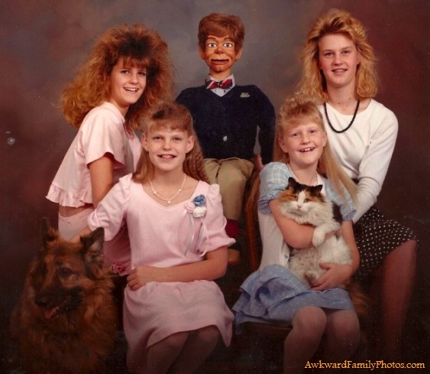
Observation versus inference

Slide 10
Example: Eliciting Hypotheses about “what might be going on”

Slide 11
Example On your post-it, answer at least one of the following questions:
What do you see going on here?
What did you notice when I put the flask on the hot plate? When I took it off?
When or where does the balloon expansion occur?

Slide 12
Example On your post-it, answer at least one of the following questions:
What do you see going on here?
What did you notice when I put the flask on the hot plate? When I took it off?
When or where does the balloon expansion occur?

Slide 13
Example In your assigned groups, choose who will take which role.
Time keeper: you will notify your group when you have 2 minutes remaining, 1 minute remaining, and 30 seconds remaining.
Recorder: you will record the answers your group comes up with on your packet.
Reporter: when time is called, you will report out to the class what your answers were to the questions.
Manager: you will make sure your group stays on-task and will (politely) redirect conversation if your group stops talking about the task at hand.

Slide 14
Example In your group, answer the following questions.
What do you think is causing the balloon to expand?
What has happened here?
What would happen if I left the flask on the hotplate?

Slide 15
Share out.

Slide 16
Stop and Think.
What are some things you noticed about teacher to student talk ratio?
What are some benefits to adapting this model to introduce big ideas in your classroom?
What are some challenges you may face by introducing this model into your classroom?

Slide 17
Creating Meaningful Group Work (10 min)
What works and what doesn’t work when it comes to group work in your classroom?

Slide 18
Creating Meaningful Group Work (10 min)
Nature of the tasks assigned
Assigning students to groups
Fostering student ownership
Interpersonal considerations
Assessment and accountability

Slide 19
1. Nature of Tasks Assigned
Short Term Work (1-2 class periods)
Make sense of something they have read
Co-construct a representation of an idea (model)
Apply existing knowledge to a new situation
Design an investigation
Critique an investigation
Collect, organize, and graph data
Interpret graphs
Develop hypotheses based on background reading
Examine and weigh out various forms of evidence
Others…

Slide 20
1. Nature of Tasks Assigned
Steps for Successful Short Term-Work Assignments
You need to make your intentions explicitly clear before students begin
Have check-in points
Monitor student activity after 10 minutes or so, making sure you’re listening to their conversations and not just checking to see if they are on-task

Slide 21
2. Assigning Students to Groups
Ideal number: 3 or 4 people per group
Groups of mixed ability, gender, and cultural background (without tokenism)
Don’t have students self-select!

Slide 22
3. Fostering Student Ownership
Assigning roles!
Take the next 2 minutes to brainstorm with your PLC some roles you could theoretically assign students.

Slide 23
3. Fostering Student Ownership
Talking Chips
Have as many colors as you have group members, and when a student wants to speak, he puts his chip in the center of the table. Everyone must use all their chips.
The colors allow you to see who has talked, and also ensures that there is equal talk time among group members.

Slide 24
4. Interpersonal Considerations
Think about building pro-personal skills into group work.
Making sure everyone has a significant role to play (both procedurally and cognitively)
This means giving everyone a chance to voice their ideas and opinions.
Commenting on the ideas of other without commenting on them as people
Making ideas public and explicit without at first passing any judgement
Building on ideas of others (kids get to listen to the thinking process of others—extremely valuable!)
Asking on-task questions that go beyond procedures and are about ideas.
Asking peers to clarify what they mean.
Peers answering the specific questions asked by their classmates.
Keeping sarcasm out of the conversation.
Others…?

Slide 25
5. Assessment and Accountability
Give students examples of what it means to contribute to group work
Tell students that you will choose someone to randomly share-out
Give everyone a group grade based on the average improvement of everyone within the group
Peer evaluations (see pages 6 and 7)

Slide 28
Reflection on Group Activity
Based on our conversations tonight, what was good about the group activity?
What could be improved with this activity?

Slide 29
Work Time
20 minutes

